Slide 1
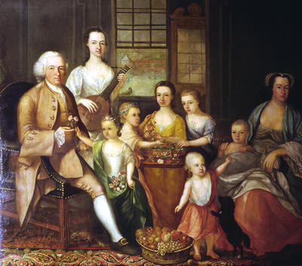
Black people in Britain in the 18th century
The curious case of the missing slave.

Slide 2
A remarkable portrait from the late eighteenth century depicts a wealthy Glasgow merchant, John Glassford, surrounded by his family and with a black servant standing behind
OK?
Any problems?

Slide 3
So where is the black attendant?

Slide 4
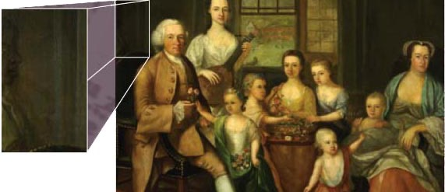
Can you see him now?

Slide 5
So what happened to the slave?
In fact, at some point in the nineteenth century, the servant was painted out. We only know about this because modern X-ray techniques have rediscovered the image of the black attendant in recent years.
In your groups of 3, see who can come up with the most likely answer. You have 5 minutes to do this. Start thinking!

Slide 6
Why was he ‘painted out’? Which explanation would you vote for?
A. He wasn’t their slave any more. He had moved to another master’s house.
C. At the time he was painted out people were against the slave trade. Glassford didn’t want to be associated with the slave trade in any way.
B. The family was embarrassed because they once had a black slave, which may seem racist.
D. It made a better picture without him. He always looked as if he was only half in the picture.

Slide 7
The answer?
No one is quite sure why: was it because of sensitivities during the anti-slavery campaign at the beginning of the 19th century, or did it arise from a desire to render the portrait ‘racially pure’?

Slide 8
John Glassford (1715–1783) was one of the main merchants popularly known as the 'tobacco lords' who became very wealthy by trading in tobacco grown in the American colonies with slave labour. He owned several trading stores and plantations in Virginia and Maryland. His wealth is demonstrated by the opulence of the house (for example the rich carpet underfoot) and by the sheer size (1.98 x 2.21 metres) and magnificence of the oil painting itself. www.glasgowmuseums.com

Slide 9
Credits
With thanks to the Museum of Glasgow

