Slide 1
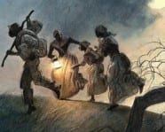
Planning an escape as a runaway slave
Why did some succeed in running away and others got caught?

Slide 2
Can you work out who was most likely to run away successfully?

Slide 3
When a slave or servant ran away, masters often placed remarkably detailed advertisements for their return. Sheriffs and other county officials also often advertised the capture of runaways or suspected runaways.

Slide 4
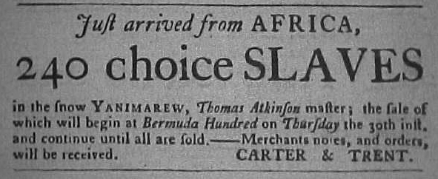
Let’s look at one example
In 1770, three newly imported Africans ran away from James Buchanan of Richmond. They had arrived in a cargo of 240 slaves

Slide 5
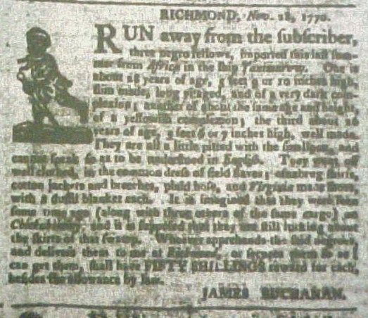
Advertisement/Reward offered

Slide 6
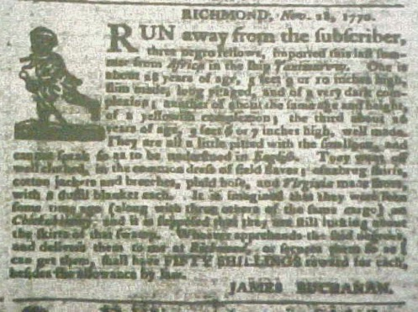
RICHMOND, November 28, 1770
RUN away from the subscriber, three negro fellows, imported from Africa in the ship Yanimarew. One is about 28 years of age, 5 feet 9 or 10 inches high, slim made, long visaged, and of a very dark complexion; another of about the same age and complexion; the third about 26 years of age, 5 feet 6 or 7 inches high, well made. They are all a little pitted with the smallpox, and cannot speak so as to be understood in English.
When the ship arrived, smallpox was raging aboard, and the 240 Africans on board were quarantined ashore.

Slide 7
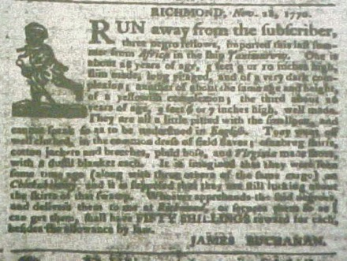
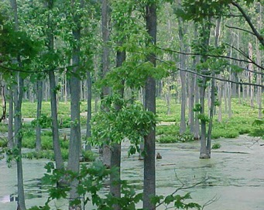
They went off well clothed, in the common dress of field slaves; osnabrug (linen) shirts, cotton jackets and breeches, plaid hose, and Virginia made shoes, with a dual blanket each. It is imagined that they were seen some time ago (along with three others of the same cargo) on Chicahominy, and it is supposed that they are still lurking about the skirts of that swamp.
The swamp today

Slide 8
Background
According to the ad, Buchanan has based his guess as to where they had gone on the testimony of an eyewitness who saw the runaways near the swamp, although we do not know how reliable the evidence was.

Slide 9
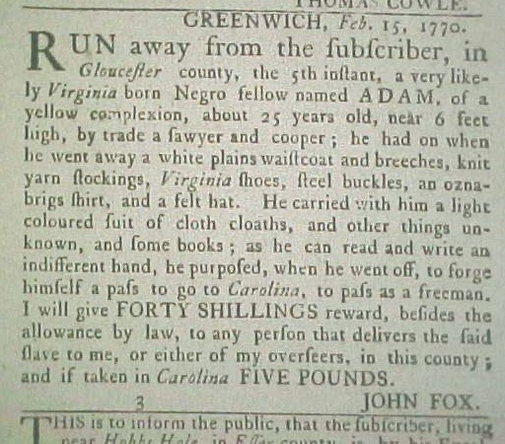
Let’s do one together
This advert appeared in the Virginia Gazette on 22 February 1770
As I read it through, I’ll try to explain how I try to understand what its saying. Then you will have a go with a document of your choice. Ready?

Slide 10
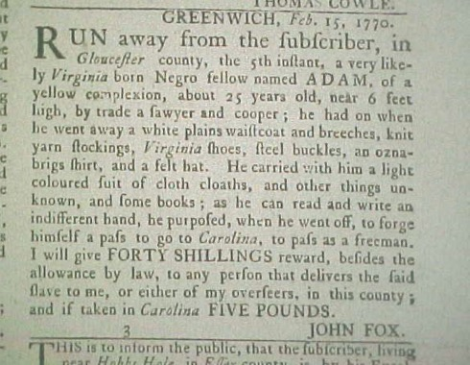
GREENWICH, Feb. 15, 1770. RUN away from the subscriber, in Gloucester county, the 5th instant,
a very likely Virginia born Negro fellow named Adam, of a yellow complexion, about 25 years old, near 6 feet high, by trade a sawyer and cooper;

Slide 11
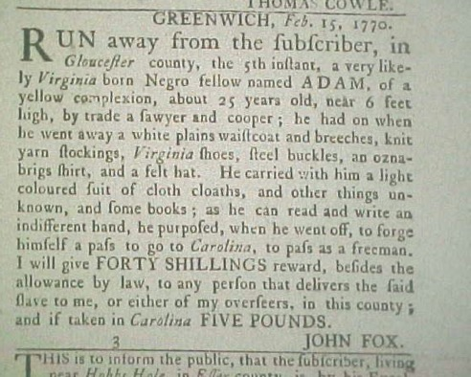
……he had on when he went away a white plains waistcoat and breeches, knit yarn stockings, Virginia shoes, steel buckles, an oznabrigs shirt and a felt hat.
He carried with him a light coloured suit of cloth cloaths, and other things unknown, and some books;
as he can read and write an indifferent hand he purposed, when he went off, to forge himself a pass to go to Carolina, to pass as a freeman.

Slide 12
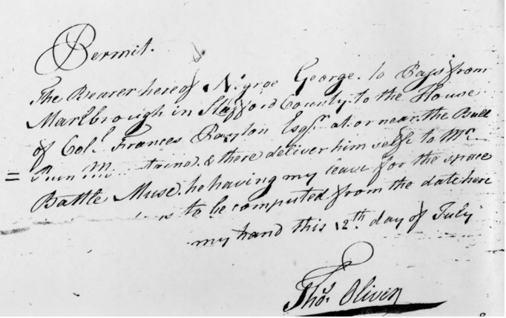
A pass looked like this.
What do you think the first word says?

Slide 13
Reward
I will give FORTY SHILLINGS reward, besides the allowance by law, to any person that delivers the said slave to me, or either of my overseers, in this county; and if taken in Carolina FIVE POUNDS. JOHN FOX.

Slide 14
Teachers notes refers to slide 10
"GREENWICH, [I need to look at a map of Virginia in the 18th century to find out exactly where this is] Feb. 15, 1770 [It must have been a cold time to runaway]. RUN away from the subscriber [I think that might mean the person who placed the ad], in Gloucester county , the 5th instant [I have read a lot of these ads and I know that this means the 5th of this month. Looking back up at the dates, I see that he must have run away on the 5th, the owner placed the ad on the 15th, and the newspaper came out on the 22nd.], a very likely [this is an odd use of the word ‘likely’.– maybe he’s likely to be a good worker Virginia born Negro fellow named ADAM, of a yellow complexion (why yellow? Seems weird), about 25 years old, near 6 feet high, by trade a sawyer and cooper [this must be some sort of profession but I will need to research this, I found out that one means saws wood, the other that he makes barrels]

Slide 15
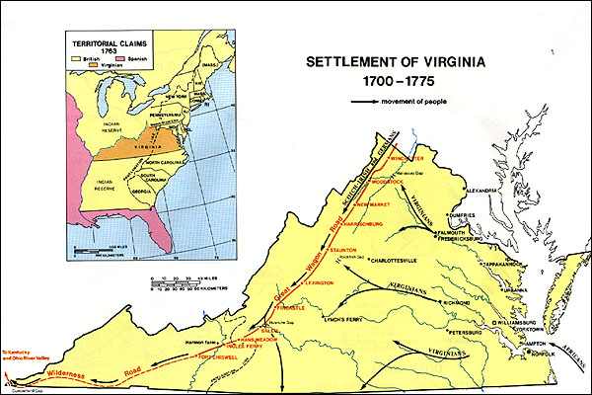

Slide 16
Teachers notes slide 11
he had on when he went away a white plains waistcoat and breeches [that reminds me of britches – maybe it means trousers], knit yarn stockings, Virginia shoes, steel buckles, an oznabrigs shirt [what a strange shirt – I have no idea what type of cloth that might be, but I don’t think it’s a very nice fabric if slaves wore it] , and a felt hat. He carried with him a light coloured suit of cloth cloaths [I wonder why he would carry extra clothes if he was trying to make a quick getaway. Maybe they would be useful as a disguise or maybe to trade for food], and other things unknown, and some books; as he can read and write [I'm surprised he can read and write. I wonder how he learned] an indifferent hand [I know this word to mean “showing no feeling” but maybe it means his handwriting is passable but nothing special] he purposed, when he went off, to forge himself a pass [I guess this means he had to have a pass to even be off his owner's property] to go to Carolina, to pass as a freeman (I guess this means not a slave any more).

Slide 17
Teachers notes slide 13
I will give FORTY SHILLINGS [I have to investigate how much that is, sounds a lot] reward, besides the allowance by law, to any person that delivers the said slave to me, or either of my overseers, in this county; and if taken in Carolina FIVE POUNDS [I don’t know anything about their money except that one pound equalled 20 shillings]. JOHN FOX.

Slide 18
Weigh up this runaway’s chances of success
December 10, 1736. RAN away from my House, in York Town, the 14th of November last, a Negro Fellow, named Quash. He is middle siz'd, about 27 Years old, speaks very good English, has small Eyes, and has lost the great Toe of his right Foot: He had on, when he went away, an old Kersey Wastecoat, a very good Oznabrigg Shirt, white Cotton Breeches, Yarn Stockings, and a Pair of Shoes, with Bath Mettal Buckles. Whoever brings the said Negro to my House, shall have Ten Shillings Reward. William Nelson.
Quash speaks "very good English." This may help Quash in his efforts to escape. Although he has lost his big toe, there were no other indication that Quash was did not have the physical stamina to stay on the run. December may not be a very good time to hide outside, this could hurt Quash's chances for success. In his favour, Quash appeared to be well clothed.

Slide 19
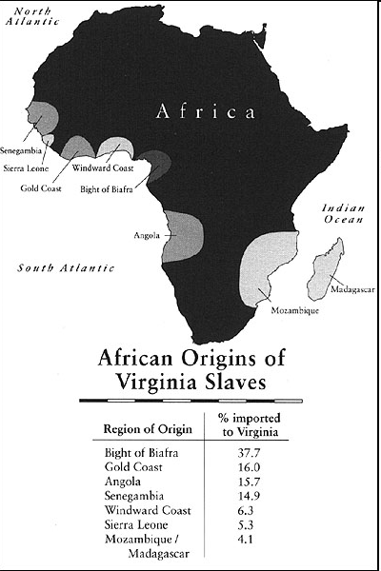

Slide 20
Credits
© Copyright 2005 by Tom Costa and The Rector and Visitors of the University of Virginia .
We are grateful to Tom for kindly allowing us to adapt his original approaches to suit a UK audience.

