Slide 1
The Gunpowder plot
Prove it!

Slide 2
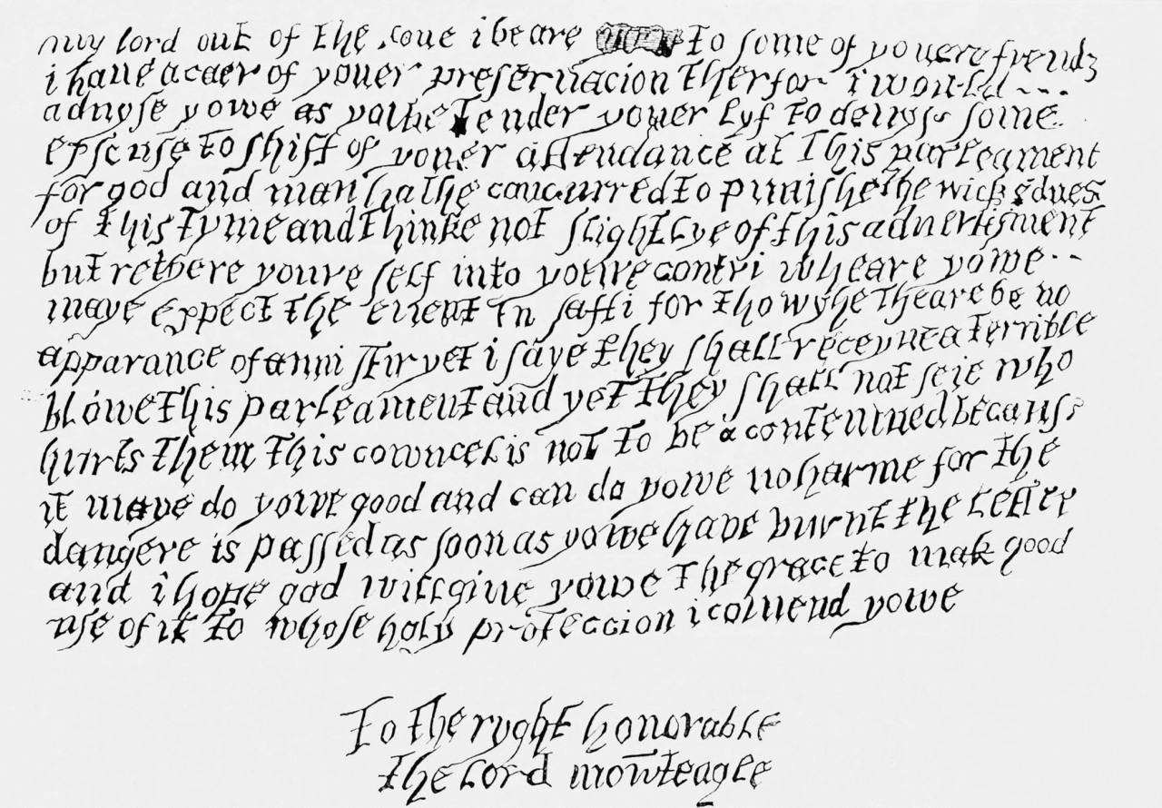
P1

Slide 3
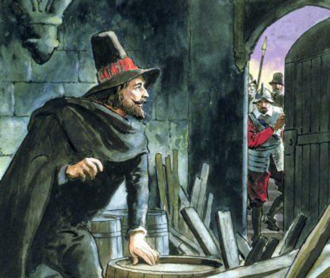
P2

Slide 4
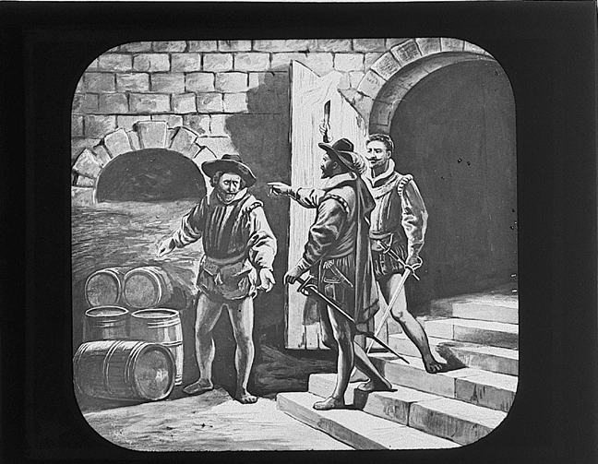
P3

Slide 5
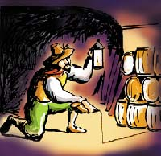
P4

Slide 6
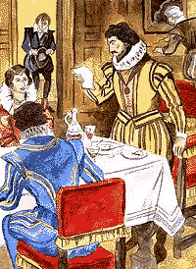
P5

Slide 7
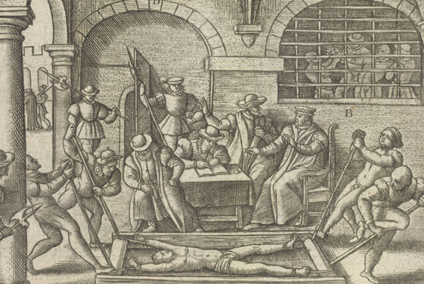
P6

Slide 8
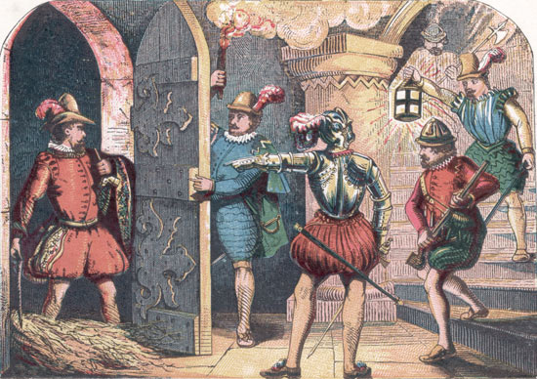
P7

Slide 9
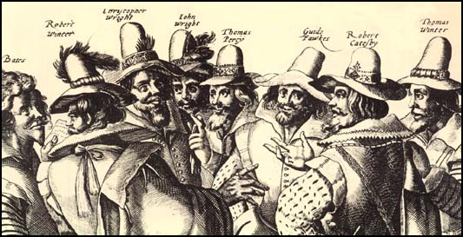
P8

Slide 10
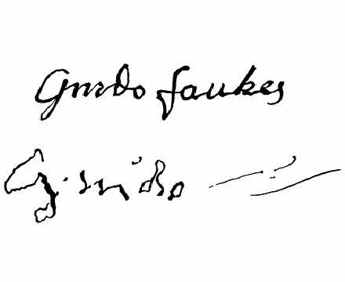
P9

Slide 11
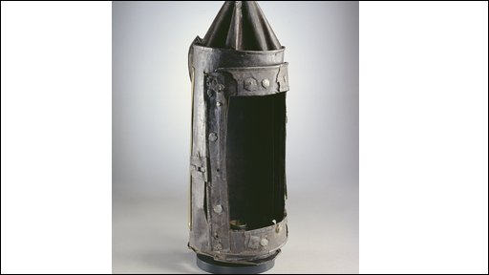
P10

Slide 12
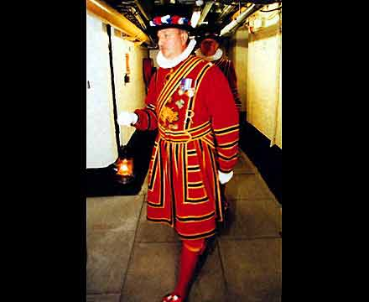
P11

Slide 13
P12

Slide 14
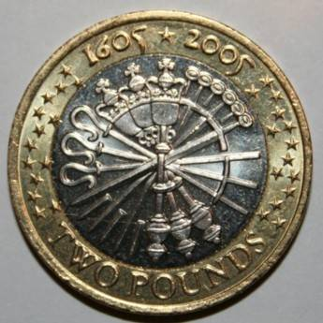
P13

Slide 15
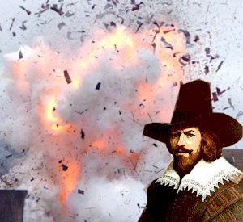
P14
Source: http://thejester.biz/jesternews/?p=345

Slide 16
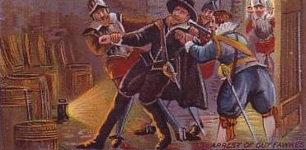
P15

Slide 17
P16

Slide 18
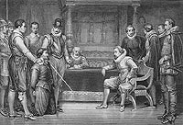
P17

Slide 19
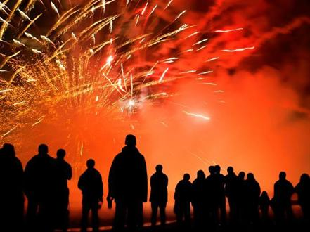
P18

Slide 20
P19

Slide 21
Credits
Slide 11 P10 http://newsimg.bbc.co.uk/media/images/46662000/jpg/_46662634_guy.jpg
Slide 14 P13 ( left) http://www.taxfreegold.co.uk/2005twopoundsgoldguyfawkes.php and ( right)
http://www.culture24.org.uk/history+%26+heritage/time/georgian+and+victorian/tra30312
Slide 17 P16.
http://www.zazzle.co.uk/guy_fawkes_mug-168797992698246931
Slide 19 P18
http://www.blackcatfireworks.co.uk/blog/wp-content/uploads/2011/08/Bonfire-night-photo.jpg

